Slide 1
What does Agile mean?
Andreas Odermatt
2016
https://github.com/odaner/whatDoesAgileMean

Slide 2
Semantic Diffusion
Semantic diffusion occurs when you have a word with a pretty good definition, but then gets spread through the wider community in a way that weakens that definition.
This weakening risks losing the definition entirely - and with it any usefulness to the term.
Martin Fowler

Slide 3
“Agile methods mean you don’t do any planning“
“Agile, do you mean Scrum?“
“Agile is a process that makes you faster“
“The thing with the sprints“
“Agile is the best methodology for every project“
“There are no managers anymore”
“These Japanese techniques”

Slide 4
This talk is highly inspired by Dave Thomas, Martin Fowler, Neal Ford and Dan North
thanks
<3

Slide 5
the implementation of something from the specification of something.
We need to separate
☺

Slide 6
Software Development in the 90‘s
99% of all software projects were like this

Slide 7
The cure
Plan-Driven Processes
Plan your work
Work your plan
Success = according to plan
(on time and on budget)

Slide 8
The core problem of the predictive process
Needs a clear and stable set of requirements
plan your work
work your plan
Plan
Product
Planning
Software Development
depends on
New Processes
Up-front requirements
Change Control Boards
Sign Offs
Requirements
Stability
Stabilize
Get rid of the dependency!

Slide 9
From predictive to adaptive planning
Predictive Process
Adaptive Process

Slide 10
New approaches

Slide 11
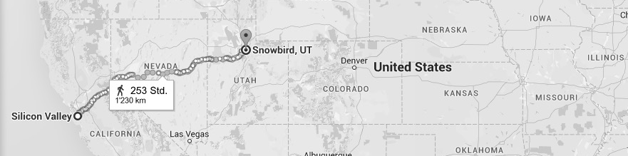
Angry
Engineers
New
Ideas
OOPSLA
Con

Slide 12
After less than 1 day, they came up with
a short list of values
Individuals and Interactions over Processes and Tools Working Software over Comprehensive Documentation Customer Collaboration over Contract Negotiation, and Responding to Change over Following a Plan

Slide 13
There was extra time left.
They did what developers do.
They filled in the time with some random stuff.
Principles
Welcome changing requirements, even late in development. Agile processes harness change for the customer's competitive advantage.
Business people and developers must work together daily throughout the project.
Build projects around motivated individuals. Give them the environment and support they need, and trust them to get the job done.
The best architectures, requirements, and designs emerge from self-organizing teams.

Slide 14
They just published their stuff on the web
the
Manifesto for Agile Software Development
was born

Slide 15

And that was it
And that was probably a mistake.

Slide 16
What has happened since?
evil stuff

Slide 17
The root of all the evil
(that’s where the developers take a large part of the blame)
Developers ❤️ new, bright & shiny things.
Agile was the cool new thing out there.
What, you aren’t doing Agile?

Slide 18
The root of all the evil - Nr. 2
The Manifesto tells you WHY to develop agile. But not HOW.

Slide 19
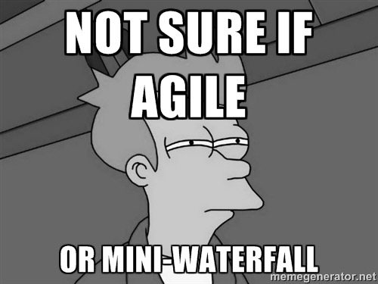
People get nervous
(particularly management)
We want to be cool too, but
This is strange!
How do we use this?
Are we doing it right?

Slide 20

Fear sells
New roles
New words
New ways to plan
New ways to measure
New ways to manage and lead

Slide 21
Let’s summarize
We have a popular, cool new movement
There are many proofs that “it” really works Great products have been developed
Teams and customers are happier than before
This leads to
Agile became the mainstream alternative
Many people want to do ”it” but don’t know how
The “it” is not yet defined
There’s no copyright or trademark

Slide 22
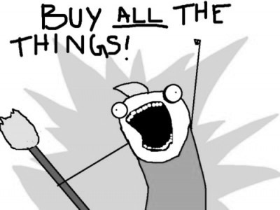
That’s an opportunity to sell stuff!
We teach you HOW to do “it” right
Books
Trainings
Conferences
Consultancy
But what’s “it”?

Slide 23

Evil Nr. 3 – The „it“
Manifesto for Agile Software Development
people call it
The Agile Manifesto

Slide 24
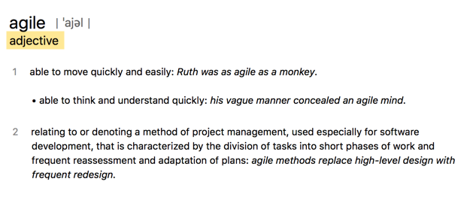
agile is an adjective
Hi, I’m the
agile Manifesto

Slide 25
Adjectives don’t sell
Nouns sell.
So, they converted agile into a noun.
Agile Alliance
How to do Agile
Agile for Dummies
Scaling Agile
Agile this, Agile that…

Slide 26

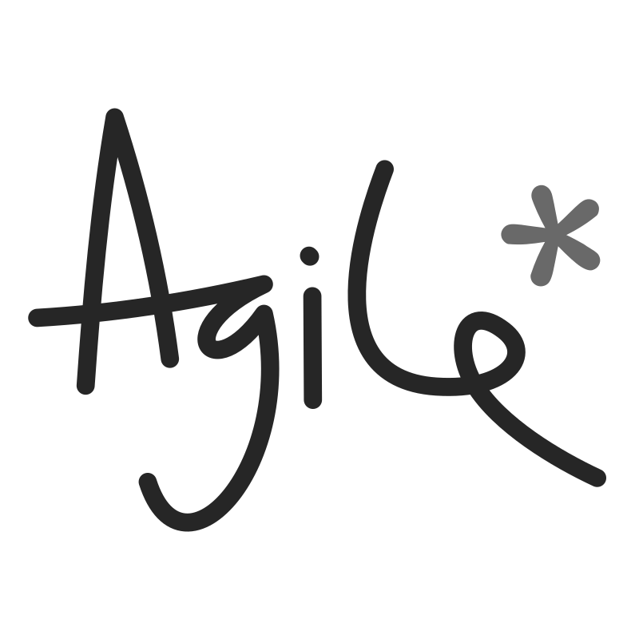
They succeeded
Agile became
a marketing term.

Slide 27
Agile is the brand
What is the product it sells?

Slide 28
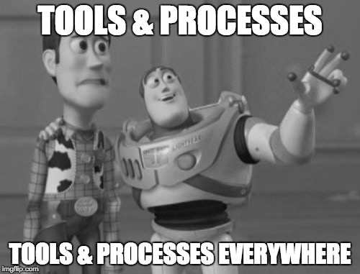
Scrum
Kanban
SAFe
TDD
GitFlow
Pull Request
Jira
Wiki
CI
Docker
Jenkins
Slack

Slide 29
The Agile product
buy tools. adapt processes.
BE FASTER!
(and cool)

Slide 30
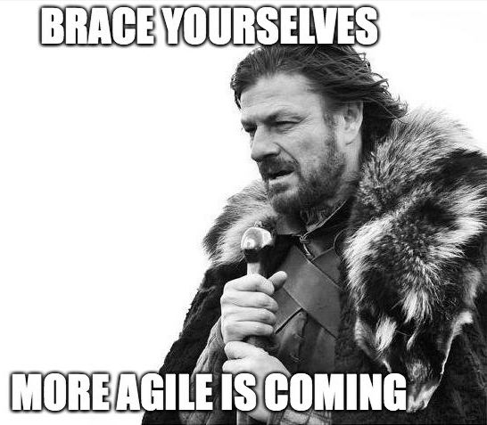
What’s next?

Slide 31
Every industry wants to grow
The agile practices
like XP and Scrum
were designed for small teams.
But the money is in the big companies.
Let’s scale it!

Slide 32
You need an Agile Organization
Agile Management (3.0)
Agile Requirements Engineering
Agile Testing
Agile Architecture
Agile Integration and Delivery

Slide 33
Agile has become an industry
The values and principles
have been totally lost.
A word that is abused in
this way becomes useless.
It stops having meaning
as it transitions into a brand.
Dave Thomas

Slide 34
Play the game? Back to plan-driven processes?
What to do?

Slide 35
Back to the basics
Individuals and Interactions over Processes and Tools Working Software over Comprehensive Documentation Customer Collaboration over Contract Negotiation, and Responding to Change over Following a Plan
inspect & adapt

Slide 36
Individuals and Interactions over Processes and Tools
The people involved and how they bond as a team are the primary driver behind success.
Don’t fit people into a process. Let them choose the process they follow.
A bad process will beat a good person/team every time.
Sticky notes on walls are better than any “Agile Tool”.
Processes (and tools) can enhance a team's effectiveness, but are always second-order influences.

Slide 37
Working Software over Comprehensive Documentation
Release often
Build prototypes and make a POCs
Focus on the product and it’s features
Reduce ”work in progress” → get stuff done!
Beware of your Definition of Done

Slide 38
Customer Collaboration over Contract Negotiation
Make a demo early!
Get feedback from people (and software).
Fail fast, fail cheap
Transparency
No finger-pointing, blaming, cover-my-ass-strategies
Collaboration over Specification

Slide 39
Responding to Change over Following a Plan
We welcome changing requirements.
Responding to change a competitive advantage.
Our plans are constantly changing to reflect the things we learn during a project.
Plan adaptive rather than predictive.

Slide 40
Communication
People and communication are the number 1 reason for failing software projects – not technology
Direct, face-to-face communication
Frequent communication & feedback
Business people and developers work together
Daily, Story Time, Planning, Retrospectives

Slide 41
Software Design & Agile
Agile & adaptive planning needs an evolutionary design.
People tend to only take the project management stuff but not the technical stuff.
Technical practices are a very important part of Agile Software Development
Self-Testing Code, CI/CD, Refactoring, simple design.
We need software that is designed for change.

Slide 42
Individuals & Team
You’ll not perform if you don’t have the skills
Think & act as a team
Trust & respect
Write down your principles

Slide 43
There’s one more thing.

Slide 44
Maybe, it‘s time to kill the word “Agile”
Reclaim Agility!
Because we don‘t want to stop
doing things agile.

Slide 45
We’ve lost the word agile. Let’s try to hang on to agility. Let’s keep it meaningful, and let’s protect it from those who would take the soul of our ideas in order to sell it back to us.
Dave Thomas

Slide 46
Agility: 3 Steps + 1 Loop
(by Dave Thomas)
What to do
Find out where you are
Take a small step towards your goal
Adjust your understanding based on what you learned
⟳ Repeat
How to do it
When faced with two or more alternatives that deliver roughly the same value, take the path that makes future change easier.

Slide 47
The essence of Agility
You aren’t an agile programmer - you’re a programmer who programs with agility.
You don’t work on an agile team
- your team exhibits agility.
You don’t use agile tools
- you use tools that enhance your agility.

Slide 48
Get rid of the dependency.
Expect and welcome changing requirements
Responding to a late change in requirements
is a major competitive advantage.

Slide 49
Plan-Driven
Agility
Predictive Planning
Adaptive Planning
Process-first
People-first
Reports &
Boards
Transparency & Communication

Slide 50
Sources
http://agilemanifesto.org
http://pragdave.me/blog/2014/03/04/time-to-kill-agile/
https://youtu.be/a-BOSpxYJ9M
https://youtu.be/GE6lbPLEAzc
https://vimeo.com/44234746
https://www.artefactgroup.com/content/post-agile-a-design-thinking-approach-to-software-development/
http://martinfowler.com/bliki/SemanticDiffusion.html
http://martinfowler.com/articles/newMethodology.html
http://martinfowler.com/articles/designDead.html
https://github.com/oreillymedia/97-things-every-agile-developer-should-know/blob/master/Beware_Of_Agile_Zealots.asciidoc

Slide 51
What does Agility mean to you?
Thank you
https://github.com/odaner/whatDoesAgileMean

